Slide 1
Exploration of Reusable Learning Objects in Distance Education Course Design
USDLA 2010
Andrea Gregg – Senior Instructional Designer
Lynne Johnson – Senior Instructional Designer

Slide 2
Presentation Outline
Penn State World Campus Snapshot
Why a Content Object Repository?
Phase I – Requirements & System Selection
Phase II – Pilot System Internally
Phase III – Pilot System Externally
Questions and Discussion

Slide 3
Penn State World Campus Snapshot

Slide 4
Penn State Historical Snapshot
1855: Penn State Founded
1892: First Penn State Correspondence Study Program offered
Through 2007: Penn State offered paper-based Independent Learning courses

Slide 5
World Campus Historical Snapshot
1997: Penn State formed World Campus with the charge to offer online courses
1998: The first 4 online courses (of 4 programs) launched
2010: 66 degree and certificate programs
2010: On average 500 sections a semester

Slide 6
Penn State
President/Provost
Academic courses
World Campus
Deans
Colleges
Program Planning & MGMT
Student Services
Learning Design
Marketing
Faculty Development
Dept Heads
Departments
Help Desk
Central Admin
Faculty

Slide 7
World Campus Learning Design
Design, develop, and deliver World Campus online courses
instructional designers; educational technologists; multimedia specialists
Integrated with student support systems
Responsible for exploring, piloting, and implementing Content Object Repository

Slide 8
Why a Content Object Repository?

Slide 9
Why a Content Object Repository?
Better resource utilization within Learning Design
Blended Learning Initiative
Flexible Design Initiative
Notes:
1. First point is simply that we have a lot of multimedia, etc. that is not centrally located. So we have some wasted time spent re-inventing the wheel.
2. Enable more effective use of learning materials across Penn State courses and campuses. Improve quality of instruction in high enrolling courses. Enable hybrid/blended courses where appropriate. Reduce instructional cost while maintaining or increasing levels of student learning and satisfaction. (started in 2004, to be a 3 year initiative, we have continued to receive funding from the provost. Penn State initiative – cross University- Involves WC and ETS, academic units, Schreyer)
3. The World Campus has been considering and moving toward a more flexible philosophy and approach to learning design. This approach would provide a greater ability for faculty to modify the courses they are teaching. There must be some balance, however, between rigid course structures and completely flexible ones. That balance must recognize the need to have efficiencies and to be able to scale courses.

Slide 10
Better Resource Utilization
Current workflow often means “reinventing the wheel”
Notes:
1. First point is simply that we have a lot of multimedia, etc. that is not centrally located. So we have some wasted time spent re-inventing the wheel.
2. Enable more effective use of learning materials across Penn State courses and campuses. Improve quality of instruction in high enrolling courses. Enable hybrid/blended courses where appropriate. Reduce instructional cost while maintaining or increasing levels of student learning and satisfaction. (started in 2004, to be a 3 year initiative, we have continued to receive funding from the provost. Penn State initiative – cross University- Involves WC and ETS, academic units, Schreyer)
3. The World Campus has been considering and moving toward a more flexible philosophy and approach to learning design. This approach would provide a greater ability for faculty to modify the courses they are teaching. There must be some balance, however, between rigid course structures and completely flexible ones. That balance must recognize the need to have efficiencies and to be able to scale courses.

Slide 11
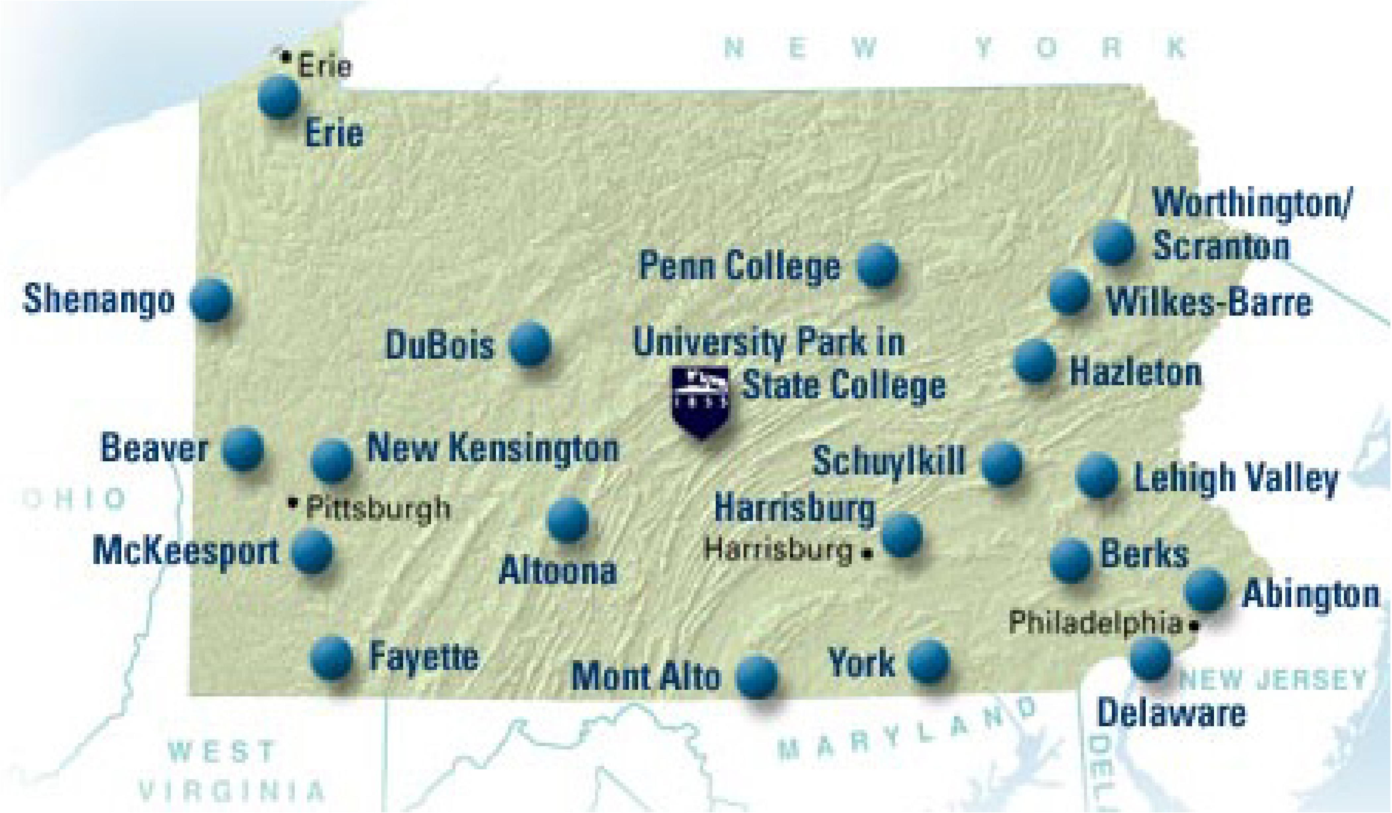
Blended Learning Initiative
Notes:
Curricular integrity, consistency

Slide 12
Flexible Design Initiative
Independent Learning Study Guides
Changes made with errata sheets
DreamWeaver pages and web server
Changes typically not made as course ran
Current Landscape
More requests for flexibility; more comfort with web technologies; more browser-based editors
Notes:
Independent Learning Study guides – with errata
Web 1.0 and Dreamweaver – not a lot of options to edit content – we had it all on our server
Web 2.0, faculty comfort with CMS, want to be more than graders when they are teaching online

Slide 13
Realities
Workflow/Policy
Politics
Business Realities
Philosophy
Notes:
Workflow: With any implementation of a content object repository, there are a set of realities that in many ways are completely unrelated to the technology itself yet have tremendous impact on it. These are listed in the order that is easiest to deal with. First, is workflow. We ran into this in terms of how we would more efficiently upload items as they were being created. When do the multimedia people upload it? Full or compressed version? Whose responsible for tagging? Policy has to do with unit and university policy. How do we tag objects? Do we classify things by college, program, course, etc.
Politics: Faculty X created this and does not want to share with Faculty Y as that will give away important documents.
Business Realities: (Sometimes contradictory) Create more online courses, quicker with more standardization. Also, let faculty do more content creation themselves, provide more flexibility. Be sure to capture any changes.
Philosophy/Religion: Content is ubiquitous. We should not reinvent the wheel. All content should be open and free. Content must be Penn State [insert your institution here] quality. It must be trademarked that way. We lose educational value if everything is available to everyone.

Slide 14
Necessities
Reliable
Flexible
Scalable
Customizable
Granular-”able” (in terms of permissions)
Notes:
Obviously, we cannot resolve those tensions in this short presentation. We wanted to highlight them because it’s inevitable that those discussions will emerge if you are exploring this type of implementation. Before we dug into very specific system requirements, we knew there were some key things htat the system had to do regardless.

Slide 15
Phase I – Requirements & System Selection
Notes:
Based on the needs that Andrea shared for a content repository, we started a formal requirements and system selection process in summer of 2008. In the next part of the presentation, I’ll talk about that process.

Slide 16
Exploration Team
Started with Multimedia Asset Management committee
Designers
Multimedia Specialists
Educational Technologists
Metadata Specialist
BLI Representative
Unit Director
Determine requirements
Notes:
We began the system selection by assembling a committee with various people in learning design. We wanted to gather requirements from internal stakeholders with different backgrounds and priorities so we chose one individual from each functional team within learning design. We do have one metadata specialist who serves as an expert on cataloguing and managing data. We included our unit director because the committee would be making a recommendation and would need his buy-in for the funding.
We didn't include faculty at this point because we were in an exploratory phase and we don't have faculty assigned to the World Campus. We felt it was too early to ask for volunteers.

Slide 17
Requirements
Easy to use
Allows tagging, sharing, and reuse
Source files should be downloadable
Browser independent
Integrates with major LMSs
Scalable
Supports standards such as SCORM, IMS
Authentication standards such as Shibboleth and LDAP
Notes:
Number 1: It must be easy to use or faculty and staff will not support it no matter how well it works.
Faculty should be able to contribute and search for content without training.
Tagging is important for searching which relates back to easy to use. The repository had to have a robust tagging feature that allowed unlimited text.
We use the ANGEL management system but we're in the process of exploring new systems so we wanted the repository to integrate with multiple systems.
Standardization allows for more portability among systems.
Needed to be able to pass Penn State authentication to the system.

Slide 18
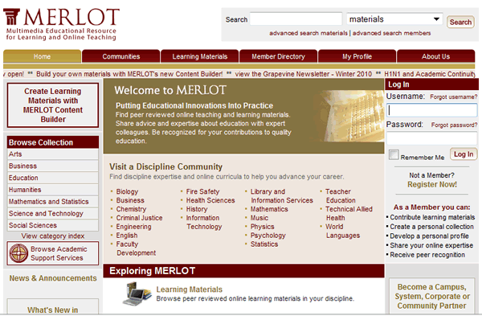
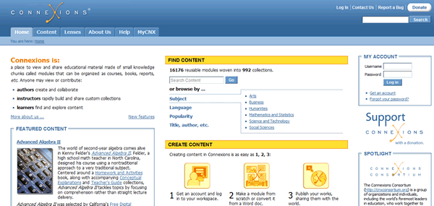
Open Courseware Systems
Notes:
Reviewed open systems such as MERLOT, MIT OpenCourseWare, Connexions. We wanted to see how they were organized, what types of resources they stored and how easy it was to search for and find information.

Slide 19
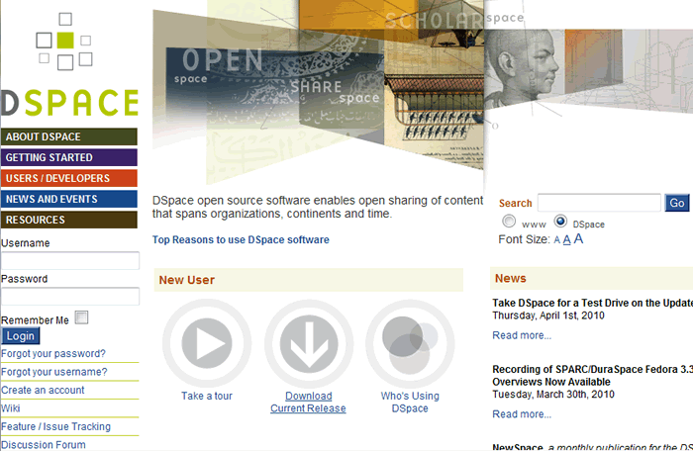
Open Source System
D-Space
Notes:
We looked at D-Space which is open source but our IT manager felt it would be too much work for the programmers to set up custom installation and manage it.

Slide 20
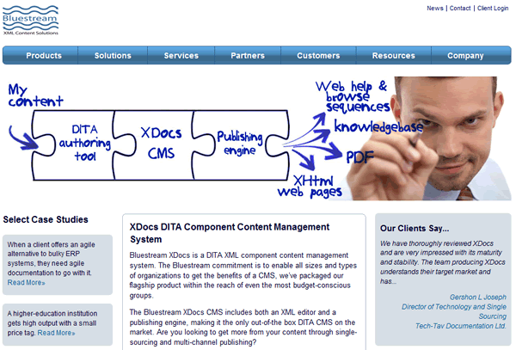
Commercial Systems
Notes:
The committee reviewed North Plains and Bluestream but ultimately chose another commercial system…

Slide 21
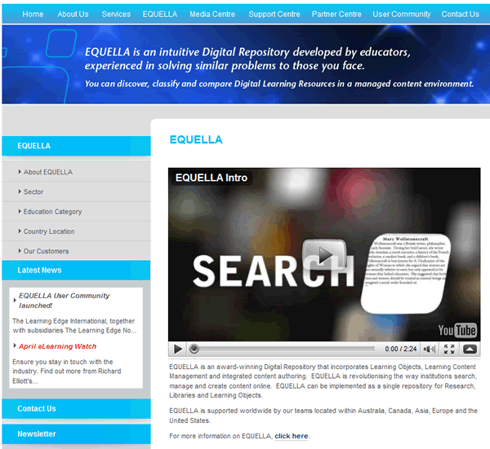
Equella
http://www.equella.com/index.php
Notes:
Equella seemed best-suited for higher ed. It was very customizable and the company was willing to work with us to creates an instance was tailored to our workflow.
They sent two programmers to Penn State to provide training. One lead the training while the other made changes to the system to meet our needs. They spent a week with us.
If you'd like more info about Equella, go to www.equella.com.

Slide 22
Phase II – Pilot System Internally

Slide 23
Internal Pilot Committee
Tasked to explore:
Configuration of the system
Integration of an appropriate metadata scheme
How to get content into the system
Ease of use
Links to OER repositories
Copyright tagging around creative commons
Notes:
Prior to the Equella training, we created a pilot committee with members similar to the Multimedia Asset Committee.
The pilot committee had nine months to explore, test, and implement the content repository. They were tasked to
Populate Equella
Perform user testing with staff and revise as needed
Document best practices
Create FAQs and tutorials
Develop inhouse training

Slide 24
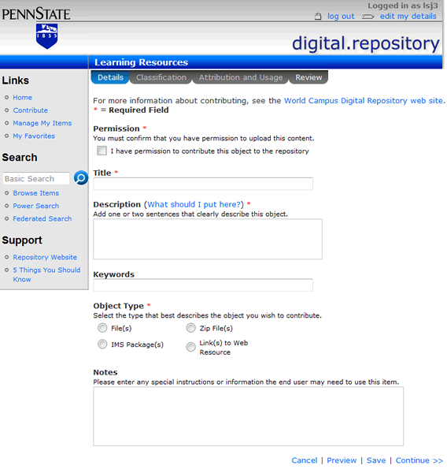
Contribution Wizard - Details
x
Notes:
Customize contribution Wizard
Challenges
Permissions
Keywords

Slide 25
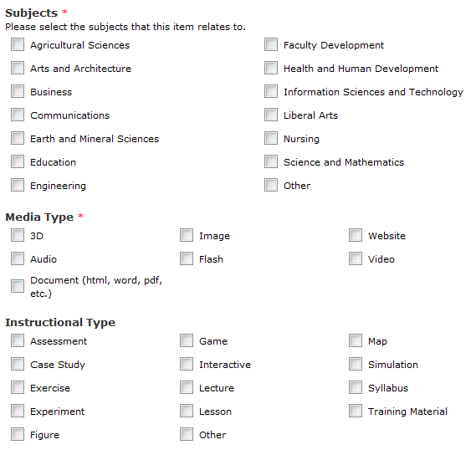
Classification
Notes:
Challenges – subjects, media types, instructional types

Slide 26
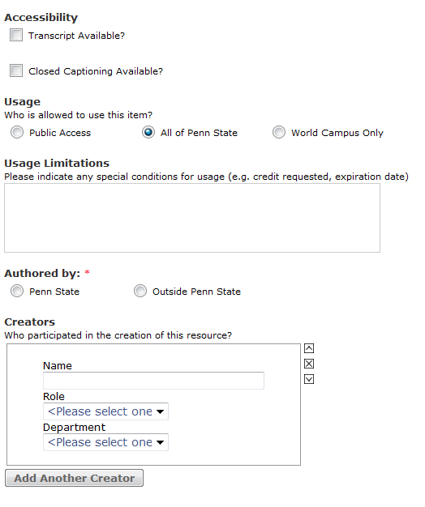
Attribution and Usage
Notes:
Challenges - usage

Slide 27
User Testing Round 1
Tested 3 users
Focused on contributing
Sample results
Users missed couldn’t find Save link
Downloads are browser dependent
Users couldn’t find the Edit option
Users unable to change the state of an option
Notes:
We started with internal user testing because we wanted to address as many issues as we could prior to faculty testing. We didn’t want to discourage faculty from using the system during the pilot. The testing was done in one session with users given a brief introduction to the process and presented with a series of 6-8 tasks to complete over 30 minutes. The users were asked to talk through their steps to explain what they were thinking as they attempted to accomplish the tasks. The test was followed by a brief interview during which the users offered feedback on the tool and testing process. Screen capture software recorded all of the audio and screen activity during the testing.
We listed a few issues to give you an idea of the types of things we found. Based on the feedback, we made the Save link more prominent on the screen and changed some of the naming conventions. For example, Edit was actually under a tab named Administrator so we changed the name to Edit. Some issues, such as the way objects are downloaded, were addressed by going back to Equella and asking them change the functionality. Changing the state of the object from unpublished to published was another wording change.

Slide 28
User Testing Round 2
Tested 3 users using same format as round 1
Tests focused on searching the repository
Sample results
No way to get back to home page
Inadequate metadata
Icons confusing
Notes:
We used different internal testers for searching. The most valuable result of this testing was that users became keenly aware of the need for good metadata, most specifically in the title, description and keywords fields. In many cases, the descriptions displayed in the search results were ineffective in helping the user quickly understand the content of the object. This greatly affects the best practices and help documentation that will be needed for users.

Slide 29
Lessons Learned
Include all stakeholders in requirements
Provide metadata training prior to content contribution
Determine benchmarks for success

Slide 30
Phase III – Pilot System Externally

Slide 31
Next Steps
Continue populating repository
Set up reports to gauge usage
Faculty user testing
Develop support documentation
Market the repository to other university groups and departments

Slide 32
Questions and Discussion

